Slide 1




How to derive deterministic approximations from the stochastic model of enzyme kinetics?
João Luiz de Oliveira Madeira
SAMBa Cohort 8
Joint work with Fernando Antonelli (Unifesp – Brazil)

Slide 2

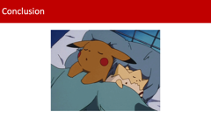
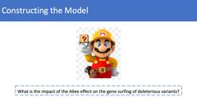
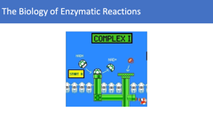

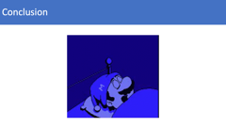
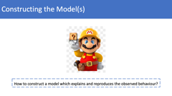


Topics

Slide 3
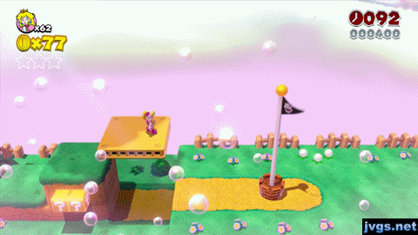
Aims
To introduce the idea of “convergence” of stochastic interacting particle systems to ODEs
Apply this concept to a model with multiple time scales which is crucial to mathematical biology
Rigorous math is FUN…
AND useful!

Slide 4

The Biology of Enzymatic Reactions

Slide 5
The Biology of Enzymatic Reactions
Enzymes are proteins that accelerate the conversion of other molecules, but they themselves are not changed by the reaction → basic biological catalysts
Enzymatic reactions are ubiquitous in biological systems
Basic model in biochemical networks
+
+
Enzyme
Substrate
Complex
Enzyme
Product
(Keener 2009)

Slide 6
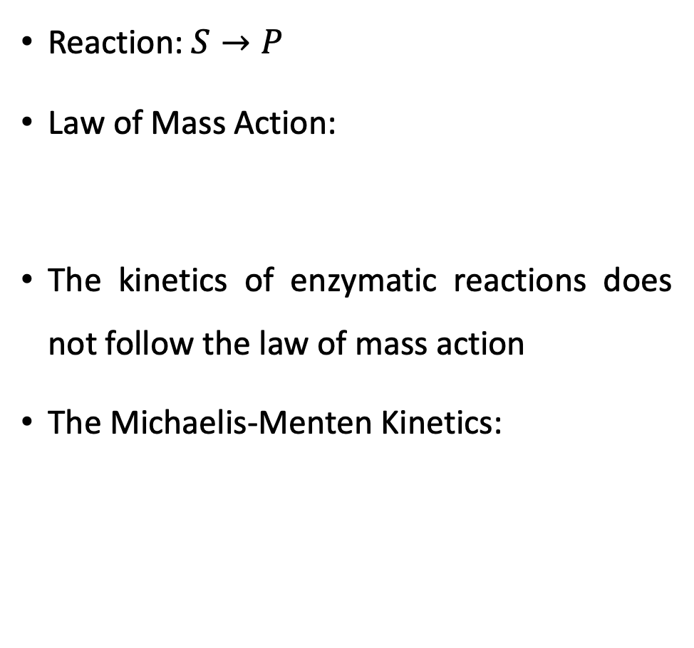
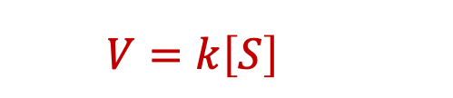
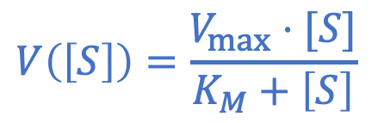
The Michaelis-Menten Kinetics
Reaction: $S→P$
Law of Mass Action:
The kinetics of enzymatic reactions does not follow the law of mass action
The Michaelis-Menten Kinetics:
$$V=k\left[S\right]$$
$$V\left(\left[S\right]\right)=\frac{V_{max}⋅[S]}{K_{M}+\left[S\right]}$$
(Michaelis and Menten 1913, Keener 2009)

Slide 7

Constructing the Model(s)
How to construct a model which explains and reproduces the observed behaviour?

Slide 8
Modelling
Quasi-Steady State Deterministic Approximation
(QSSA)
Stochastic Interacting Particle System

Slide 9
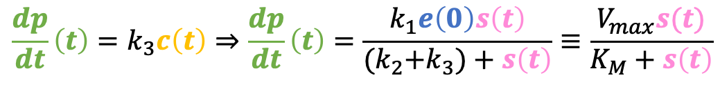
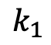
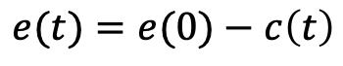
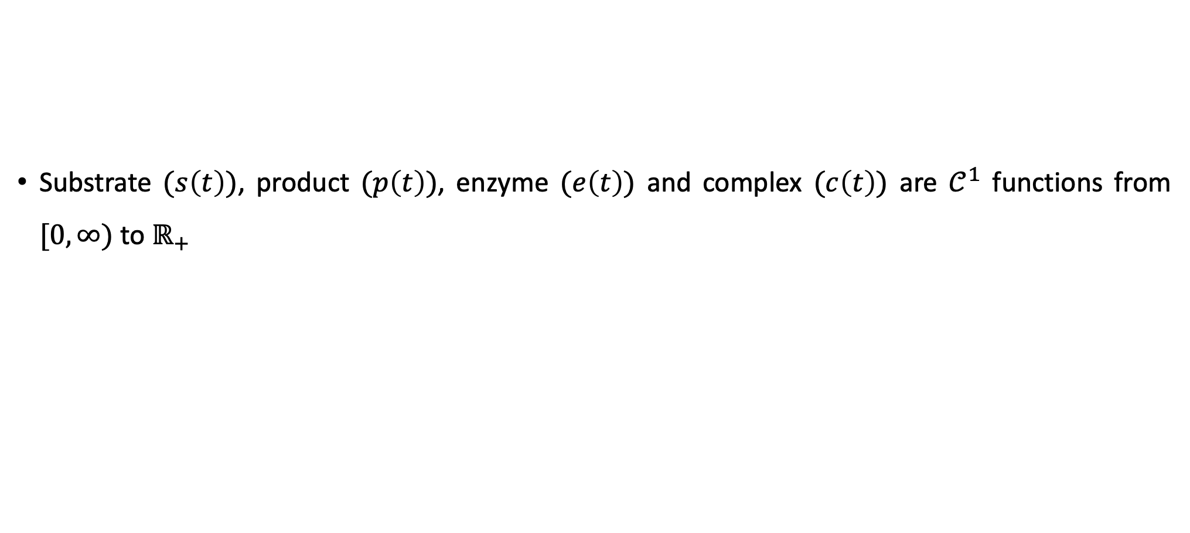
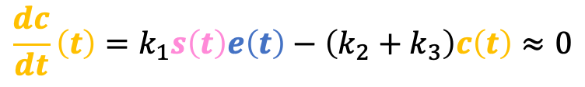
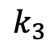
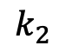
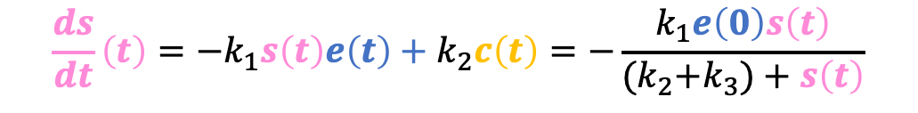
Quasi-Steady State Deterministic Approximation
Substrate $(s\left(t\right))$, product $(p\left(t\right))$, enzyme $(e\left(t\right))$ and complex $(c\left(t\right))$ are $𝒞^{1}$ functions from $[0,∞)$ to $ℝ_{+}$
$$k_{1}$$
+
$$k_{3}$$
+
$$k_{2}$$
Enzyme
Substrate
Complex
Enzyme
Product
$$e(t)=e(0)−c\left(t\right)$$
$$\frac{dc}{dt}\left(t\right)=k_{1}s\left(t\right)e\left(t\right)−\left(k_{2}+k_{3}\right)c\left(t\right)≈0$$
$$\frac{dp}{dt}\left(t\right)=k_{3}c\left(t\right)⇒\frac{dp}{dt}\left(t\right)=\frac{k_{1}e\left(0\right)s\left(t\right)}{{(k}_{2}+k_{3})+s\left(t\right)}≡\frac{V_{max}s(t)}{K_{M}+s\left(t\right)}$$
$$\frac{ds}{dt}\left(t\right)={{−k}_{1}s\left(t\right)e\left(t\right)+k}_{2}c\left(t\right)=−\frac{k_{1}e\left(0\right)s\left(t\right)}{{(k}_{2}+k_{3})+s\left(t\right)}$$
(Briggs and Haldane 1925)

Slide 10


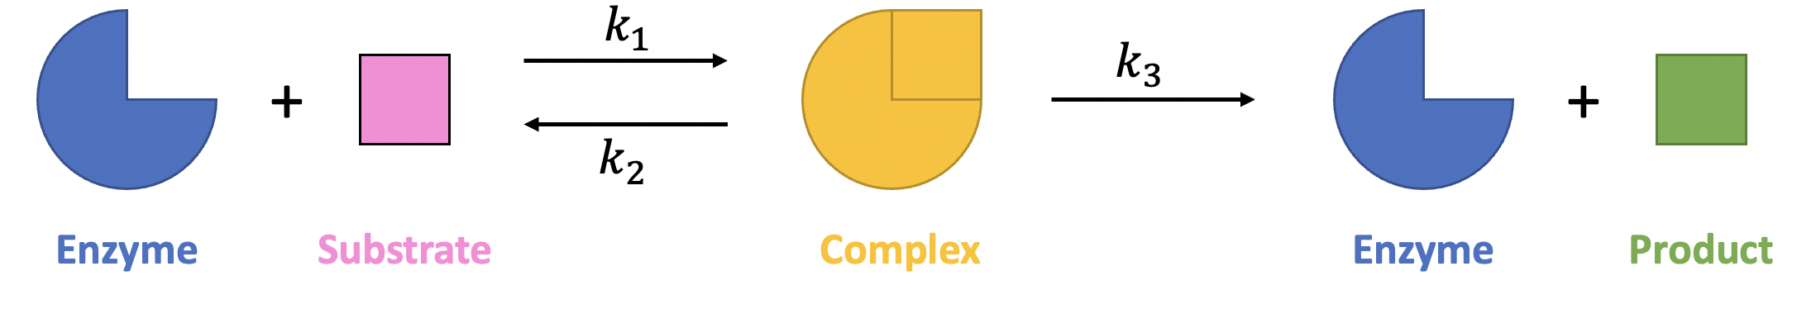
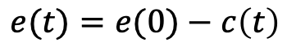
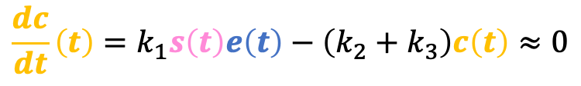
The QSSA Approach
Advantages
Disadvantages
Good fit to the data (when a large number of substrate molecules is considered)
Simple, but a meaningful, explanation
It is difficult to make the argument rigorous
It does not fit the data well for low number of molecules
$$\frac{dc}{dt}\left(t\right)=k_{1}s\left(t\right)e\left(t\right)−\left(k_{2}+k_{3}\right)c\left(t\right)≈0$$
$$e(t)=e(0)−c\left(t\right)$$

Slide 11
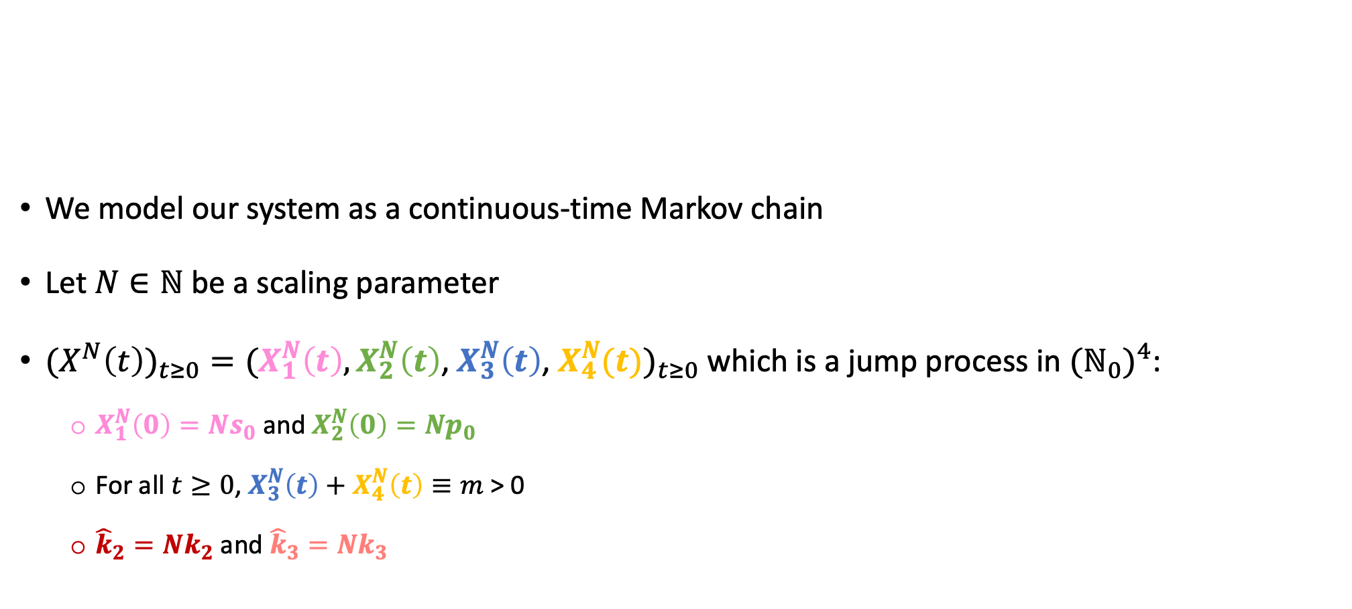
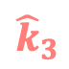
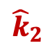
Stochastic Interacting Particle System
We model our system as a continuous-time Markov chain
Let $N∈ℕ$ be a scaling parameter
${(X}^{N}{\left(t\right))}_{t≥0}=(X_{1}^{N}\left(t\right),X_{2}^{N}\left(t\right)$, $X_{3}^{N}\left(t\right)$, $X_{4}^{N}(t))_{t≥0}$ which is a jump process in $({ℕ_{0})}^{4}$:
$X_{1}^{N}\left(0\right)=Ns_{0}$ and $X_{2}^{N}\left(0\right)=Np_{0}$
For all $t≥0$, $X_{3}^{N}\left(t\right)+X_{4}^{N}\left(t\right)≡m$ > 0
${\hat{k}}_{2}=Nk_{2}$ and ${\hat{k}}_{3}=Nk_{3}$
$$k_{1}$$
+
$${\hat{k}}_{3}$$
+
$${\hat{k}}_{2}$$
Enzyme
Substrate
Complex
Enzyme
Product
(Darden 1979)

Slide 12
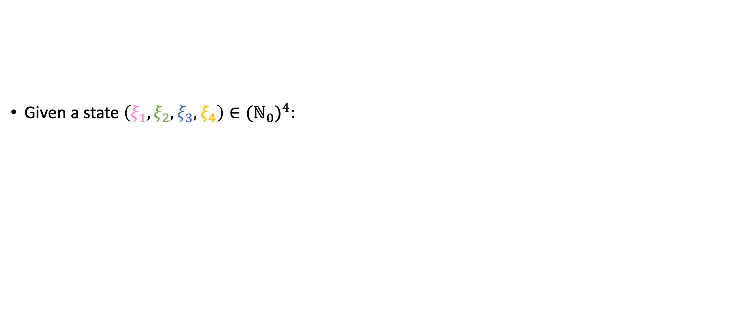
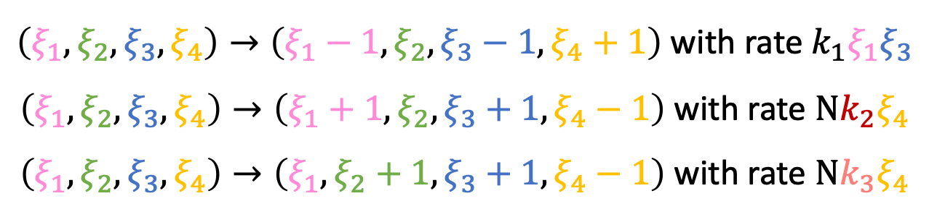
Stochastic Interacting Particle System
Given a state $\left(ξ_{1},ξ_{2}, ξ_{3},ξ_{4}\right)∈({ℕ_{0})}^{4}$:
$$k_{1}$$
+
$${\hat{k}}_{3}$$
+
$${\hat{k}}_{2}$$
Enzyme
Substrate
Complex
Enzyme
Product
$\left(ξ_{1},ξ_{2}, ξ_{3},ξ_{4}\right)→\left(ξ_{1}−1,ξ_{2}, ξ_{3}−1,ξ_{4}+1\right)$ with rate $k_{1}ξ_{1}ξ_{3}$
$\left(ξ_{1},ξ_{2}, ξ_{3},ξ_{4}\right)→\left(ξ_{1}+1,ξ_{2}, ξ_{3}+1,ξ_{4}−1\right)$ with rate $Nk_{2}ξ_{4}$
$\left(ξ_{1},ξ_{2}, ξ_{3},ξ_{4}\right)→\left(ξ_{1},ξ_{2}+1, ξ_{3}+1,ξ_{4}−1\right)$ with rate $Nk_{3}ξ_{4}$
(Darden 1979)

Slide 13
The Stochastic Interacting Particle System Approach
Advantages
Disadvantages
Good fit to the data
The description of the model is simple and precise, and it does not require any approximation
It is difficult to analyse

Slide 14

Scaling Limits of the Stochastic Model
Are the models “compatible” to each other in some sense?
How to decide which one to use?

Slide 15
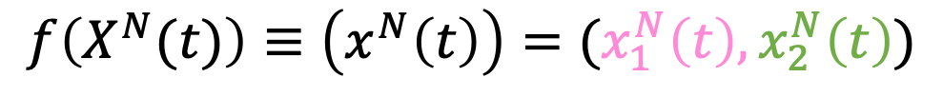
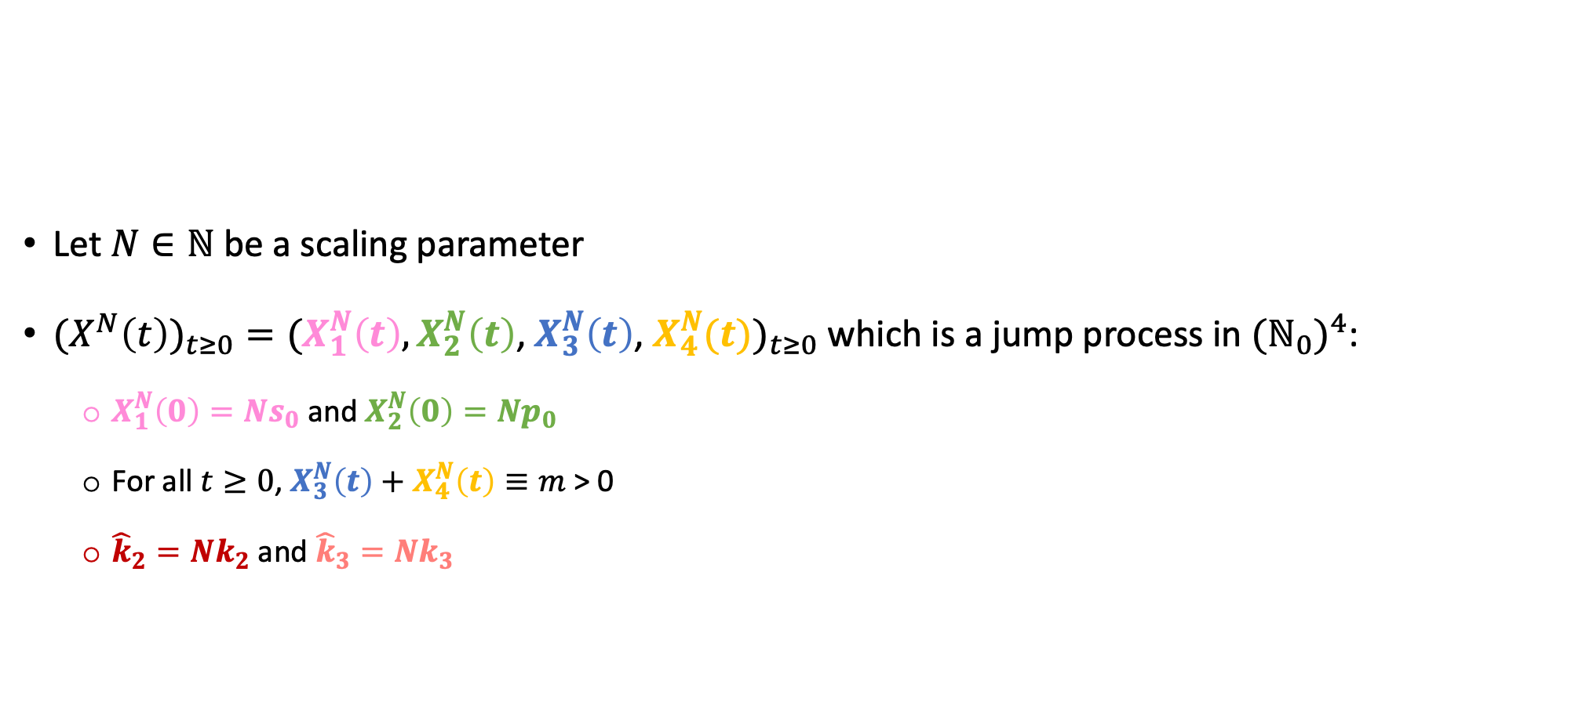
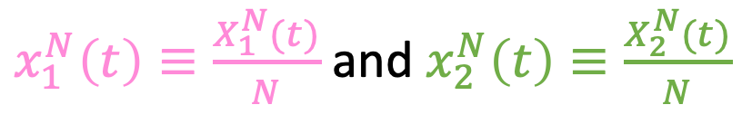
The Scaling Limit
Let $N∈ℕ$ be a scaling parameter
${(X}^{N}{\left(t\right))}_{t≥0}=(X_{1}^{N}\left(t\right),X_{2}^{N}\left(t\right)$, $X_{3}^{N}\left(t\right)$, $X_{4}^{N}(t))_{t≥0}$ which is a jump process in $({ℕ_{0})}^{4}$:
$X_{1}^{N}\left(0\right)=Ns_{0}$ and $X_{2}^{N}\left(0\right)=Np_{0}$
For all $t≥0$, $X_{3}^{N}\left(t\right)+X_{4}^{N}\left(t\right)≡m$ > 0
${\hat{k}}_{2}=Nk_{2}$ and ${\hat{k}}_{3}=Nk_{3}$
$$k_{1}$$
+
$${\hat{k}}_{3}$$
+
$${\hat{k}}_{2}$$
Enzyme
Substrate
Complex
Enzyme
Product
$x_{1}^{N}\left(t\right)≡\frac{X_{1}^{N}(t)}{N}$ and $x_{2}^{N}\left(t\right)≡\frac{X_{2}^{N}(t)}{N}$
$$f\left(X^{N}(t)\right)≡\left(x^{N}\left(t\right)\right)=(x_{1}^{N}\left(t\right),x_{2}^{N}\left(t\right))$$
(Darden 1979)

Slide 16
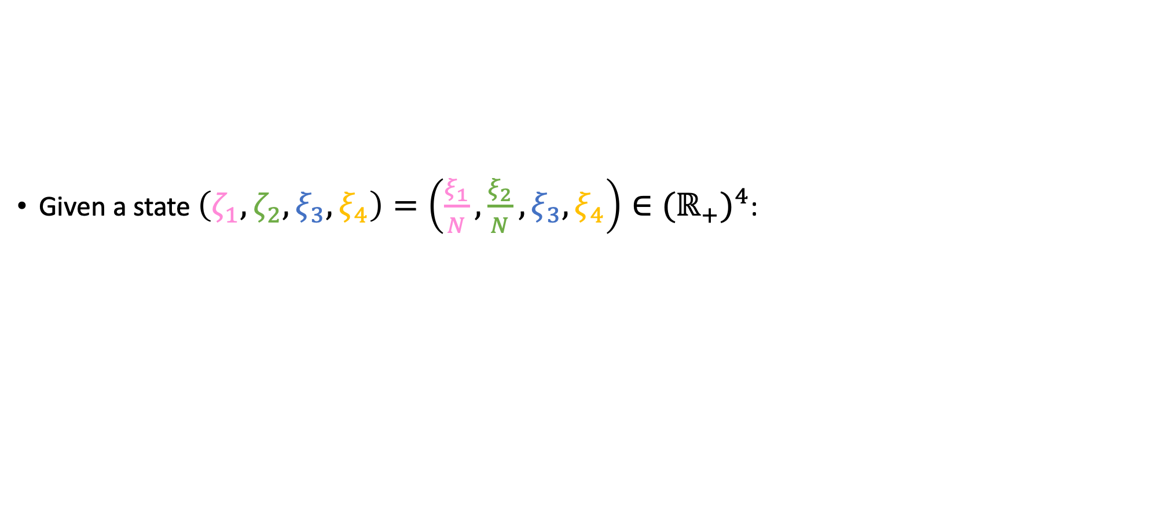
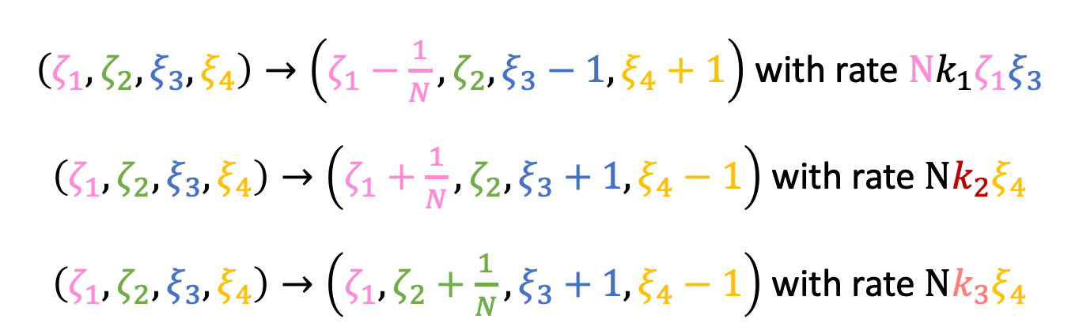
The Scaling Limit
Given a state $\left(ζ_{1},ζ_{2}, ξ_{3},ξ_{4}\right)=\left(\frac{ξ_{1}}{N},\frac{ξ_{2}}{N}, ξ_{3},ξ_{4}\right)∈({ℝ_{+})}^{4}$:
$$k_{1}$$
+
$${\hat{k}}_{3}$$
+
$${\hat{k}}_{2}$$
Enzyme
Substrate
Complex
Enzyme
Product
$\left(ζ_{1},ζ_{2}, ξ_{3},ξ_{4}\right)→\left(ζ_{1}−\frac{1}{N},ζ_{2}, ξ_{3}−1,ξ_{4}+1\right)$ with rate $Nk_{1}ζ_{1}ξ_{3}$
$\left(ζ_{1},ζ_{2}, ξ_{3},ξ_{4}\right)→\left(ζ_{1}+\frac{1}{N},ζ_{2}, ξ_{3}+1,ξ_{4}−1\right)$ with rate $Nk_{2}ξ_{4}$
$\left(ζ_{1},ζ_{2}, ξ_{3},ξ_{4}\right)→\left(ζ_{1},ζ_{2}+\frac{1}{N}, ξ_{3}+1,ξ_{4}−1\right)$ with rate $Nk_{3}ξ_{4}$

Slide 17
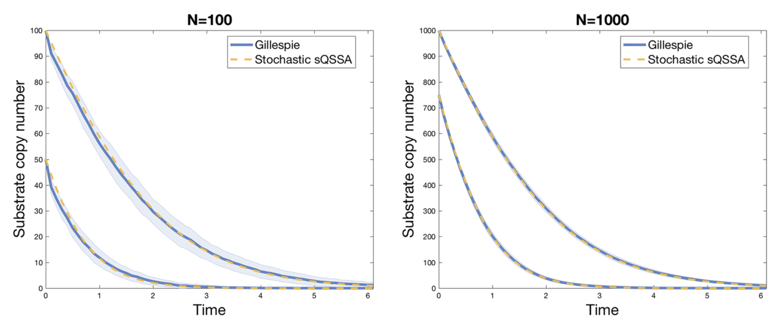

“Empirical” Evidence of Convergence
How to define convergence?
(Kang et al. 2019)

Slide 18
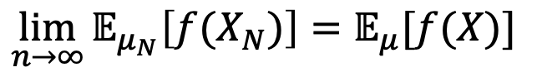
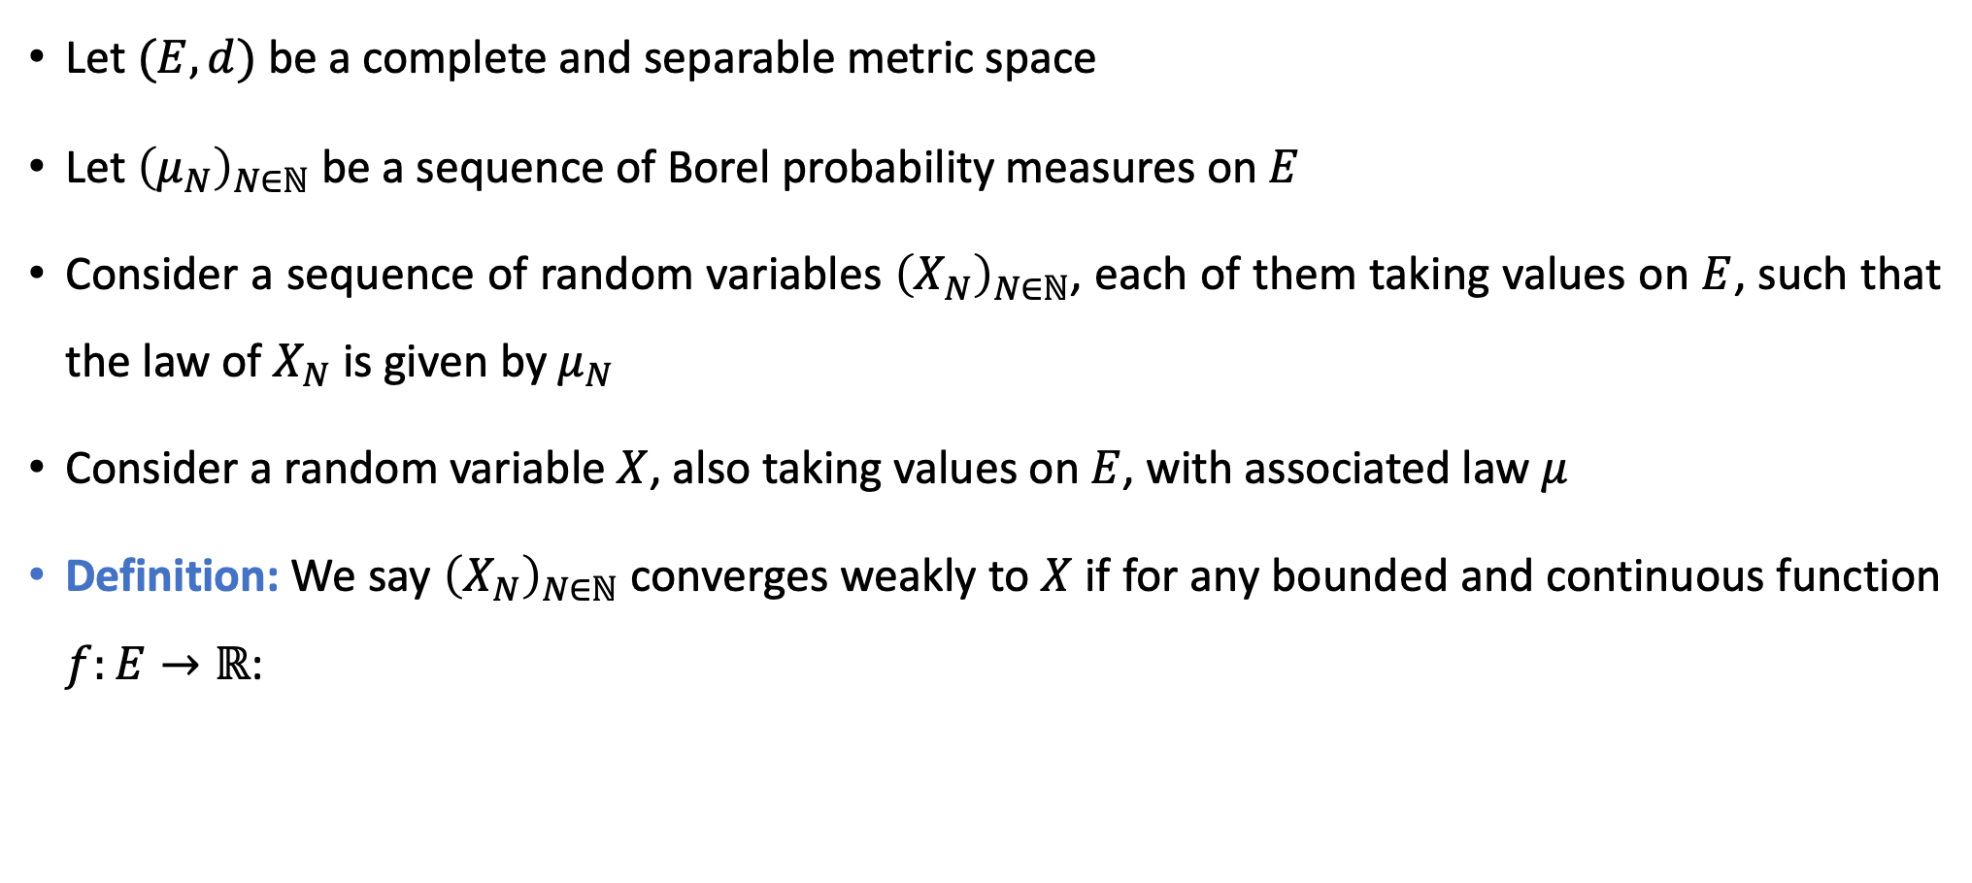
Weak Convergence of Probability Measures
Let $(E,d)$ be a complete and separable metric space
Let ${\left(μ_{N}\right)}_{N∈ℕ}$ be a sequence of Borel probability measures on $E$
Consider a sequence of random variables ${\left(X_{N}\right)}_{N∈ℕ}$, each of them taking values on $E$, such that the law of $X_{N}$ is given by $μ_{N}$
Consider a random variable $X$, also taking values on $E$, with associated law $μ$
Definition: We say ${\left(X_{N}\right)}_{N∈ℕ}$ converges weakly to $X$ if for any bounded and continuous function $f:E→ℝ$:
$$\lim_{n→∞}{𝔼_{μ_{N}}\left[f(X_{N})\right]=𝔼_{μ}[f(X)]}$$

Slide 19
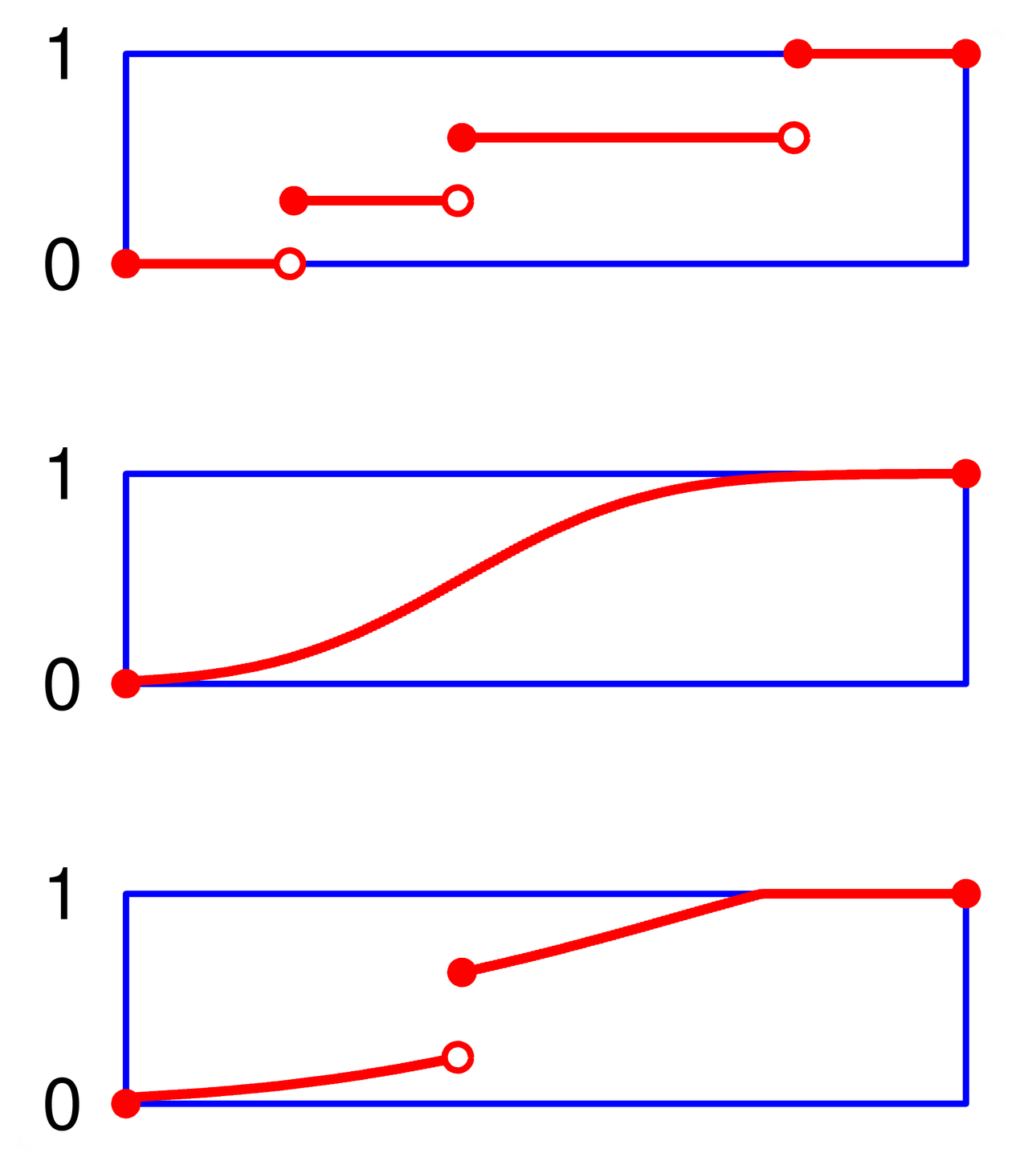
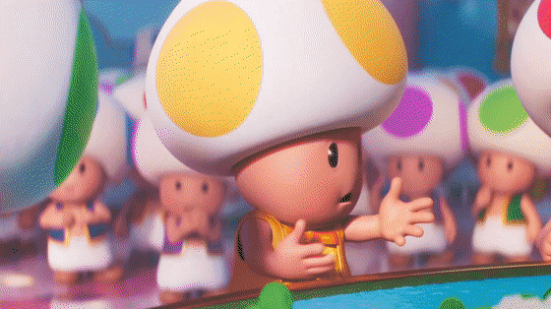
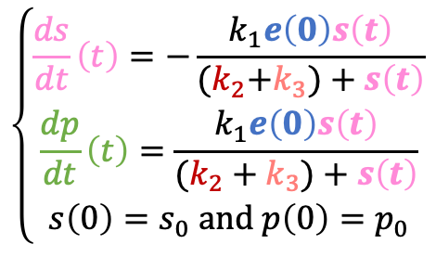
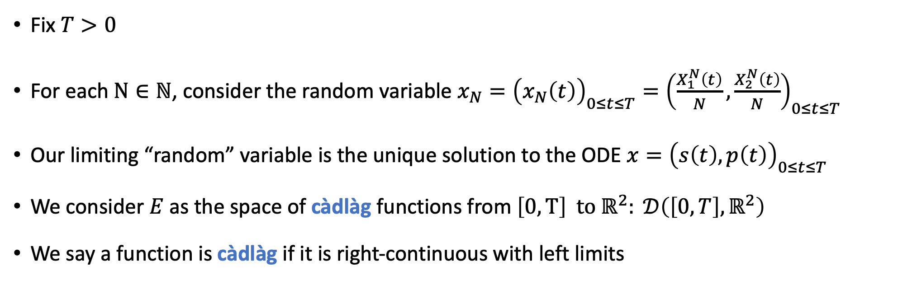
Weak Convergence in the Space of Càdlàg Functions
$$\left\{\begin{matrix}\frac{ds}{dt}\left(t\right)=−\frac{k_{1}e\left(0\right)s\left(t\right)}{{(k}_{2}+k_{3})+s\left(t\right)} \\ \frac{dp}{dt}\left(t\right)=\frac{k_{1}e\left(0\right)s\left(t\right)}{(k_{2}+k_{3})+s\left(t\right)} \\ s\left(0\right)=s_{0} and p\left(0\right)=p_{0}\end{matrix}\right.$$
QSSA model
Markov Chain
${(X}^{N}{\left(t\right))}_{t≥0}=(X_{1}^{N}\left(t\right),X_{2}^{N}\left(t\right)$, $X_{3}^{N}\left(t\right)$, $X_{4}^{N}(t))_{t≥0}$
Fix $T>0$
For each $N∈ℕ$, consider the random variable $x_{N}={\left(x_{N}\left(t\right)\right)}_{0≤t≤T}={\left(\frac{X_{1}^{N}\left(t\right)}{N},\frac{X_{2}^{N}\left(t\right)}{N}\right)}_{0≤t≤T}$
Our limiting “random” variable is the unique solution to the ODE $x={\left(s\left(t\right),p\left(t\right)\right)}_{0≤t≤T}$
We consider $E$ as the space of càdlàg functions from $\left[0,T\right] to ℝ^{2}: 𝒟\left(\left[0,T\right],ℝ^{2}\right)$
We say a function is càdlàg if it is right-continuous with left limits

Slide 20

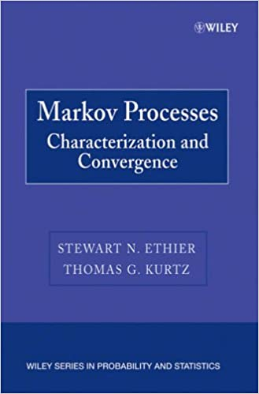
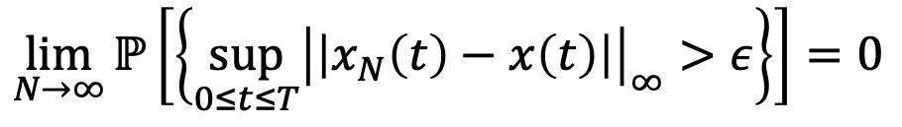
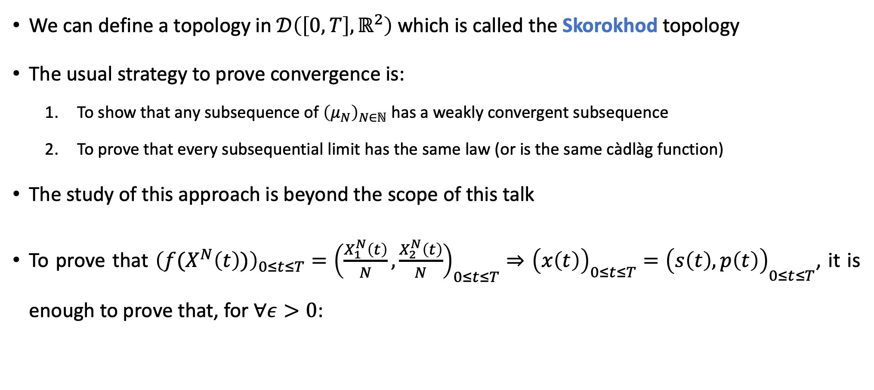
Weak Convergence in the Space of Càdlàg Functions
We can define a topology in $𝒟\left(\left[0,T\right],ℝ^{2}\right)$ which is called the Skorokhod topology
The usual strategy to prove convergence is:
To show that any subsequence of ${\left(μ_{N}\right)}_{N∈ℕ}$ has a weakly convergent subsequence
To prove that every subsequential limit has the same law (or is the same càdlàg function)
The study of this approach is beyond the scope of this talk
To prove that ${{\left(f(X^{N}\left(t\right))\right)}_{0≤t≤T}=\left(\frac{X_{1}^{N}\left(t\right)}{N},\frac{X_{2}^{N}\left(t\right)}{N}\right)}_{0≤t≤T}⇒$ ${{\left(x\left(t\right)\right)}_{0≤t≤T}=\left(s\left(t\right),p\left(t\right)\right)}_{0≤t≤T}$, it is enough to prove that, for $∀ε>0$:
$$\lim_{N→∞}{ℙ\left[\left\{\sup_{0≤t≤T}{{\left|\left|x_{N}\left(t\right)−x\left(t\right)\right|\right|}_{∞}>ε}\right\}\right]=0}$$

Slide 21
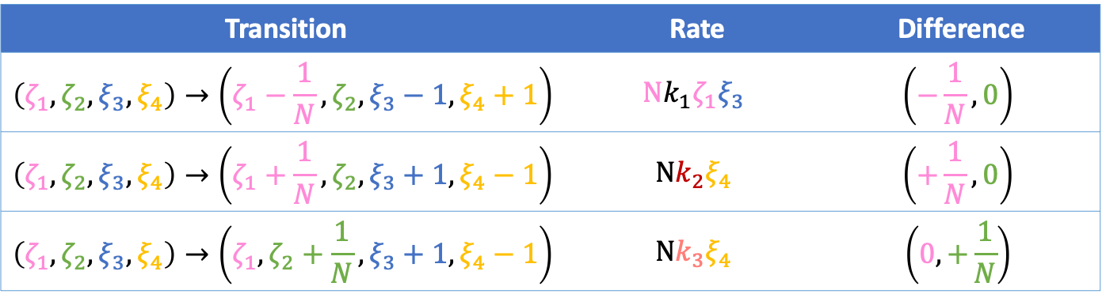
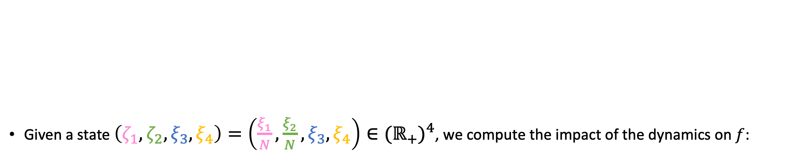
Computing the “action” of the Generator on the Slow Variables
Given a state $\left(ζ_{1},ζ_{2}, ξ_{3},ξ_{4}\right)=\left(\frac{ξ_{1}}{N},\frac{ξ_{2}}{N}, ξ_{3},ξ_{4}\right)∈({ℝ_{+})}^{4}$, we compute the impact of the dynamics on $f$:
$$k_{1}$$
+
$${\hat{k}}_{3}$$
+
$${\hat{k}}_{2}$$
Enzyme
Substrate
Complex
Enzyme
Product
Transition | Rate | Difference
$$\left(ζ_{1},ζ_{2}, ξ_{3},ξ_{4}\right)→\left(ζ_{1}−\frac{1}{N},ζ_{2}, ξ_{3}−1,ξ_{4}+1\right)$$ | $$Nk_{1}ζ_{1}ξ_{3}$$ | $$\left(−\frac{1}{N},0\right)$$
$$\left(ζ_{1},ζ_{2}, ξ_{3},ξ_{4}\right)→\left(ζ_{1}+\frac{1}{N},ζ_{2}, ξ_{3}+1,ξ_{4}−1\right)$$ | $$Nk_{2}ξ_{4}$$ | $$\left(+\frac{1}{N},0\right)$$
$$\left(ζ_{1},ζ_{2}, ξ_{3},ξ_{4}\right)→\left(ζ_{1},ζ_{2}+\frac{1}{N}, ξ_{3}+1,ξ_{4}−1\right)$$ | $$Nk_{3}ξ_{4}$$ | $$\left(0,+\frac{1}{N}\right)$$
Drift Vector: $γ_{f}\left(ξ_{1},ξ_{2}, ξ_{3},ξ_{4}\right)=\left(−k_{1}ζ_{1}ξ_{3}+k_{2}ξ_{4},k_{3}ξ_{4}\right)$

Slide 22
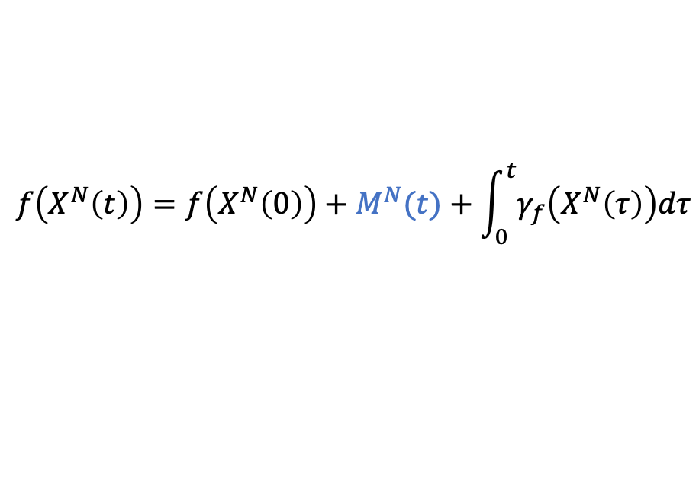
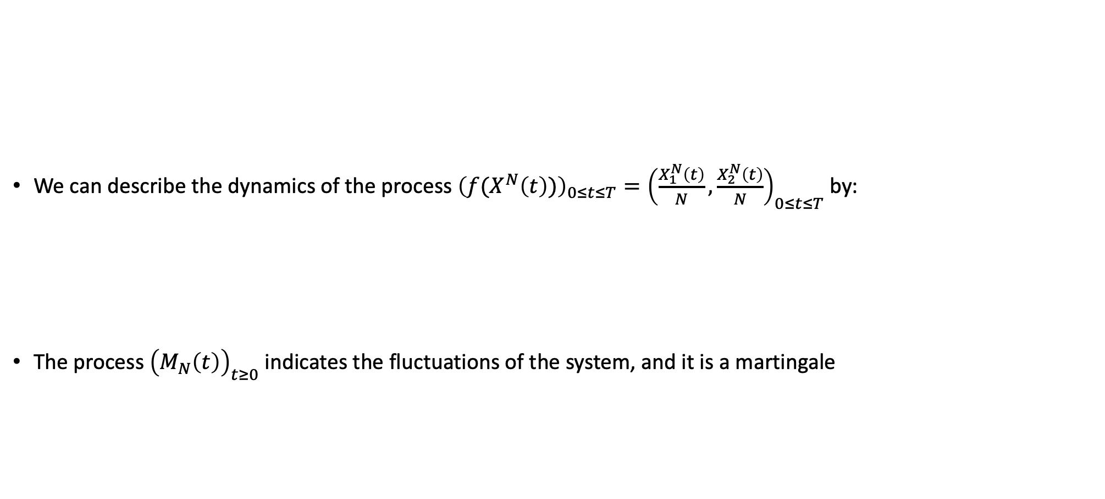
The Martingale Problem
We can describe the dynamics of the process ${{\left(f(X^{N}\left(t\right))\right)}_{0≤t≤T}=\left(\frac{X_{1}^{N}\left(t\right)}{N},\frac{X_{2}^{N}\left(t\right)}{N}\right)}_{0≤t≤T}$ by:
The process ${\left(M_{N}\left(t\right)\right)}_{t≥0}$ indicates the fluctuations of the system, and it is a martingale
$$k_{1}$$
+
$${\hat{k}}_{3}$$
+
$${\hat{k}}_{2}$$
Enzyme
Substrate
Complex
Enzyme
Product
$$f\left(X^{N}\left(t\right)\right)=f\left(X^{N}\left(0\right)\right)+M^{N}(t)+\int_{0}^{t}{γ_{f}\left(X^{N}\left(τ\right)\right)dτ}$$
Stochastic Process

Slide 23

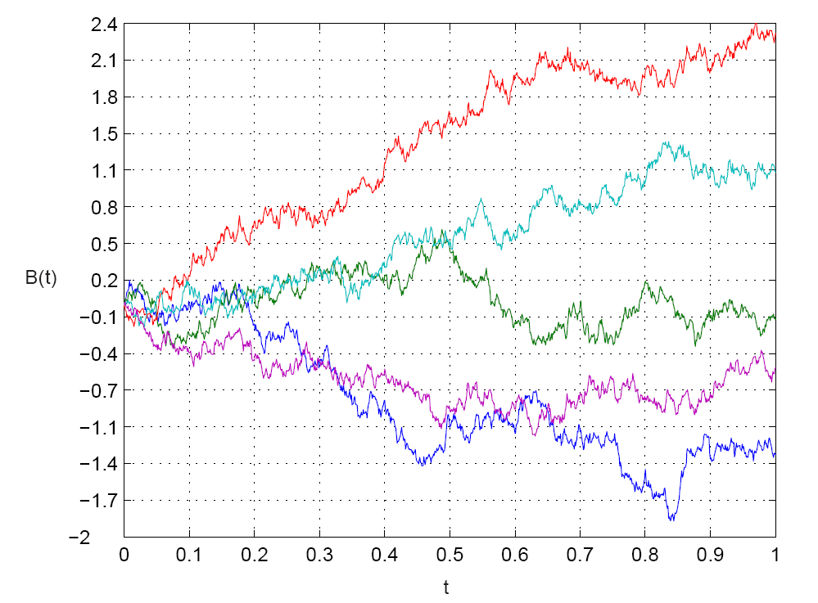
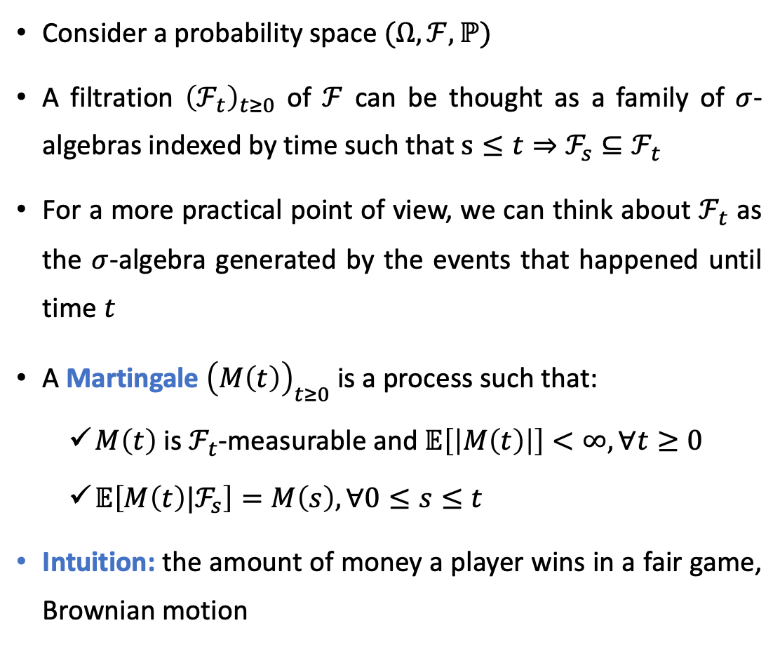
(Very) Brief Review of Martingales - I
Consider a probability space $(Ω,ℱ,ℙ)$
A filtration ${\left(ℱ_{t}\right)}_{t≥0}$ of $ℱ$ can be thought as a family of $σ$-algebras indexed by time such that $s≤t⇒ℱ_{s}⊆ℱ_{t}$
For a more practical point of view, we can think about $ℱ_{t}$ as the $σ$-algebra generated by the events that happened until time $t$
A Martingale ${\left(M\left(t\right)\right)}_{t≥0}$ is a process such that:
$M\left(t\right)$ is $ℱ_{t}$-measurable and $𝔼\left[\left|M\left(t\right)\right|\right]<∞, ∀t≥0$
$𝔼\left[M\left(t\right)|ℱ_{s}\right]=M\left(s\right), ∀0≤s≤t$
Intuition: the amount of money a player wins in a fair game, Brownian motion

Slide 24
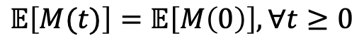
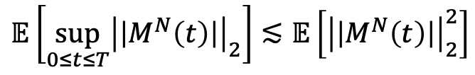
(Very) Brief Review of Martingales – II
There are really nice estimates regarding martingales
A particular case of the optional stopping theorem says that:
For example, Doob’s L2 Inequality shows that:
$$𝔼\left[M(t)\right]=𝔼\left[M\left(0\right)\right],∀t≥0$$
$$𝔼\left[\sup_{0≤t≤T}{\left|\left|M^{N}\left(t\right)\right|\right|}_{2}\right]≲𝔼\left[{\left|\left|M^{N}\left(t\right)\right|\right|}_{2}^{2}\right]$$

Slide 25
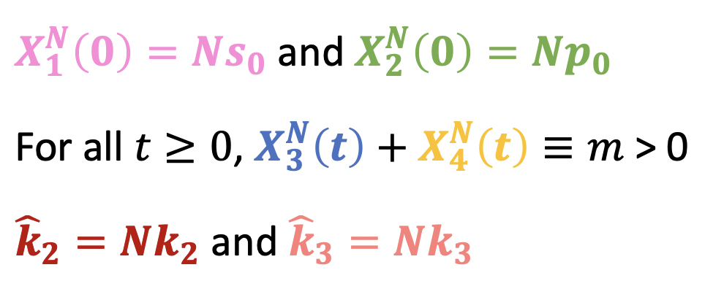
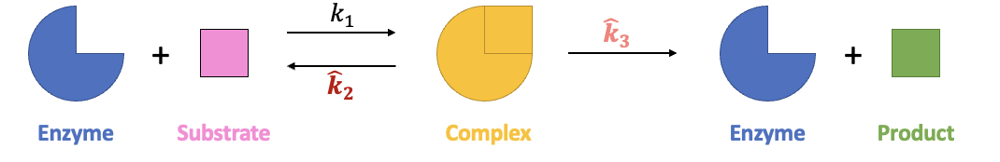



An Exponential Martingale Estimate
It is possible to construct an exponential martingale based on our Markov process and verify that (see Darling and Norris 2008):
Lemma: For $ε>0$ sufficiently small, for all $N∈ℕ,$ we have:
where:
$$ℙ\left[\left\{\sup_{0≤t≤T}{\left|\left|M^{N}\left(t\right)\right|\right|}_{∞}≥ε\right\}\right]≤4\exp\left(−\frac{ε^{2}}{2A_{f}T}\right),$$
$$A_{f}=\frac{em\left(k_{1}\left(s_{0}+\frac{m}{N}\right)+\left(k_{2}∨k_{3}\right)\right)}{N}.$$

Slide 26




Rewriting our Problem
$$k_{1}$$
+
$${\hat{k}}_{3}$$
+
$${\hat{k}}_{2}$$
Enzyme
Substrate
Complex
Enzyme
Product
$$f\left(X^{N}\left(t\right)\right)=f\left(X^{N}\left(0\right)\right)+M^{N}(t)+\int_{0}^{t}{γ_{f}\left(X^{N}\left(τ\right)\right)dτ}$$
Stochastic Process
$$\left(s\left(t\right),p\left(t\right)\right)=\left(s_{0},p_{0}\right) + \int_{0}^{t}{b\left(s\left(τ\right),p(τ)\right)dτ}$$
ODE
$$b\left(s\left(τ\right),p(τ)\right)=\left(−\frac{mk_{3}s(τ)}{\frac{k_{2}+k_{3}}{k_{1}}+s\left(τ\right) },\frac{mk_{3}s(τ)}{\frac{k_{2}+k_{3}}{k_{1}}+s\left(τ\right)}\right)$$
$$γ_{f}\left(X^{N}\left(τ\right)\right)=\left(−k_{1}\frac{X_{1}^{N}\left(τ\right)}{N}X_{3}^{N}\left(τ\right)+k_{2}X_{4}^{N}\left(τ\right),k_{3}X_{4}^{N}\left(τ\right)\right)$$

Slide 27





The Problem of the Fast Variables
Given a state $\left(ζ_{1},ζ_{2}, ξ_{3},ξ_{4}\right)=\left(\frac{ξ_{1}}{N},\frac{ξ_{2}}{N}, ξ_{3},ξ_{4}\right)∈({ℝ_{+})}^{4}$:
$$k_{1}$$
+
$${\hat{k}}_{3}$$
+
$${\hat{k}}_{2}$$
Enzyme
Substrate
Complex
Enzyme
Product
The number of molecules of enzyme and complex oscillates too fast when $N→∞$
$\left(ζ_{1},ζ_{2}, ξ_{3},ξ_{4}\right)→\left(ζ_{1}−\frac{1}{N},ζ_{2}, ξ_{3}−1,ξ_{4}+1\right)$ with rate $Nk_{1}ζ_{1}ξ_{3}$
$\left(ζ_{1},ζ_{2}, ξ_{3},ξ_{4}\right)→\left(ζ_{1}+\frac{1}{N},ζ_{2}, ξ_{3}+1,ξ_{4}−1\right)$ with rate $Nk_{2}ξ_{4}$
$\left(ζ_{1},ζ_{2}, ξ_{3},ξ_{4}\right)→\left(ζ_{1},ζ_{2}+\frac{1}{N}, ξ_{3}+1,ξ_{4}−1\right)$ with rate $Nk_{3}ξ_{4}$
No convergence can occur
We still can make some nice estimates about the integral of the path

Slide 28





Dealing with the Fast variables
We now consider the process ${\left(g\left(X^{N}\left(t\right)\right)\right)}_{t≥0}$, given by $g\left(X^{N}\left(t\right)\right)=\left(\frac{X_{3}^{N}(t)}{N},\frac{X_{4}^{N}(t)}{N}\right)$
The drift vector is now $γ_{g}\left(X^{N}\left(t\right)\right)=\left(−k_{1}\frac{X_{1}^{N}\left(t\right)}{N}X_{3}^{N}\left(t\right)+X_{4}^{N}\left(t\right)\left(k_{2}+k_{3}\right),k_{1}\frac{X_{1}^{N}\left(t\right)}{N}X_{3}^{N}\left(t\right)−X_{4}^{N}\left(t\right)\left(k_{2}+k_{3}\right)\right)$
We can again write a martingale ${\left(L^{N}\left(t\right)\right)}_{t≥0}$ associated to $g$:
$$g\left(X^{N}\left(t\right)\right)=g\left(X^{N}\left(0\right)\right)+L^{N}(t)+\int_{0}^{t}{γ_{g}\left(X^{N}\left(τ\right)\right)dτ}$$
$$A_{g}=\frac{em\left(k_{1}\left(s_{0}+\frac{m}{N}\right)+\left(k_{2}+k_{3}\right)\right)}{N}.$$
$$\sup_{0≤t≤T}{{\left|\left|\int_{0}^{t}{γ_{g}\left(X^{N}\left(τ\right)\right)dτ}\right|\right|}_{∞}≤\frac{m}{N}+\sup_{0≤t≤T}\left|\left|L^{N}\left(t\right)\right|\right|}$$
$$ℙ\left[\left\{\sup_{0≤t≤T}{\left|\left|L^{N}\left(t\right)\right|\right|}_{∞}≥ε\right\}\right]≤4\exp\left(−\frac{ε^{2}}{2A_{g}T}\right)$$

Slide 29





Finishing this (Finally)
$$k_{1}$$
+
$${\hat{k}}_{3}$$
+
$${\hat{k}}_{2}$$
Enzyme
Substrate
Complex
Enzyme
Product
$$f\left(X^{N}\left(t\right)\right)=f\left(X^{N}\left(0\right)\right)+M^{N}(t)+\int_{0}^{t}{γ_{f}\left(X^{N}\left(τ\right)\right)dτ}$$
Stochastic Process
$$\left(s\left(t\right),p\left(t\right)\right)=\left(s_{0},p_{0}\right) + \int_{0}^{t}{b\left(s\left(τ\right),p(τ)\right)dτ}$$
ODE
$$b\left(s\left(τ\right),p(τ)\right)=\left(−\frac{mk_{3}s(τ)}{\frac{k_{2}+k_{3}}{k_{1}}+s\left(τ\right) },\frac{mk_{3}s(τ)}{\frac{k_{2}+k_{3}}{k_{1}}+s\left(τ\right)}\right)$$
$$γ_{f}\left(X^{N}\left(τ\right)\right)=\left(−k_{1}\frac{X_{1}^{N}\left(τ\right)}{N}X_{3}^{N}\left(τ\right)+k_{2}X_{4}^{N}\left(τ\right),k_{3}X_{4}^{N}\left(τ\right)\right)$$
Aim: To apply Gronwall’s lemma

Slide 30





Finishing this (Finally)
$$\sup_{0≤τ≤t}{{\left|\left|f\left(X^{N}\left(τ\right)\right)−\left(s\left(τ\right),p\left(τ\right)\right)\right|\right|}_{∞}}≤{\left|\left|f\left(X^{N}\left(0\right)\right)−\left(s_{0},p_{0}\right)\right|\right|}_{∞}+\sup_{0≤τ≤t}{{\left|\left|M^{N}\left(τ\right)\right|\right|}_{∞}}$$
$$+\frac{k_{1}k_{3}m}{k_{2}+k_{3}}\int_{0}^{t}{{\sup_{0≤r≤τ}\left|\left|{f(X}^{N}\left(r\right))−\left(s\left(r\right),p\left(r\right)\right)\right|\right|}_{∞}dτ}$$
$$+\sup_{0≤τ≤t}{{\left|\left|\int_{0}^{τ}{\frac{{(k}_{1}s\left(r\right)+k_{2})}{\left(k_{1}s\left(r\right)+k_{2}+k_{3}\right)}γ_{g}\left(X^{N}\left(r\right)\right)dr}\right|\right|}_{∞}}$$
Monotonic function
$$b\left(s\left(τ\right),p(τ)\right)=\left(−\frac{mk_{3}s(τ)}{\frac{k_{2}+k_{3}}{k_{1}}+s\left(τ\right) },\frac{mk_{3}s(τ)}{\frac{k_{2}+k_{3}}{k_{1}}+s\left(τ\right)}\right)$$
Second Mean Value Theorem for Integrals: Let $h,w:\left[0,T\right]→ℝ$ such that $h$ is monotonic and $w$ is Lebesgue integrable. Then there exists $c∈[0,T]$ such that
$$\int_{0}^{T}{h\left(t\right)w\left(t\right)dt}=h\left(0+\right)\int_{0}^{T}{w\left(t\right)dt}+h(T−)\int_{0}^{T}{w\left(t\right)dt}$$
$$γ_{f}\left(X^{N}\left(τ\right)\right)=\left(−k_{1}\frac{X_{1}^{N}\left(τ\right)}{N}X_{3}^{N}\left(τ\right)+k_{2}X_{4}^{N}\left(τ\right),k_{3}X_{4}^{N}\left(τ\right)\right)$$

Slide 31







The Final Theorem (Finally)
Theorem: For the initial conditions,
and taking $f\left(X^{N}\left(t\right)\right)=\left(\frac{X_{1}^{N}(t)}{N},\frac{X_{2}^{N}(t)}{N}\right)$, we have, for all $T>0$, that:
Where
$$ℙ\left[\left\{\sup_{0≤t≤T}{{\left|\left|f\left(X^{N}\left(t\right)\right)−\left(s\left(t\right),p\left(t\right)\right)\right|\right|}_{∞}>C_{N,ε}e^{DT}}\right\}\right]≤4\left[\exp\left(−\frac{ε^{2}}{2A_{f}T}\right)+\exp\left(−\frac{ε^{2}}{2A_{g}T}\right)\right],$$
$$A_{f}=\frac{em\left(k_{1}\left(s_{0}+\frac{m}{N}\right)+\left(k_{2}∨k_{3}\right)\right)}{N}$$
$$\frac{ds}{dt}\left(t\right)=−\frac{k_{1}ms\left(t\right)}{{(k}_{2}+k_{3})+s\left(t\right)}$$
$$C_{N,ε}=ε+3\frac{{(k}_{1}s_{0}+k_{2}) }{k_{2}+k_{3}}\left(\frac{m}{N}+ε\right)$$
$$D=\frac{k_{1}k_{3}m }{k_{2}+k_{3}}$$
$$A_{g}=\frac{em\left(k_{1}\left(s_{0}+\frac{m}{N}\right)+\left(k_{2}+k_{3}\right)\right)}{N}$$
$$\frac{dp}{dt}\left(t\right)=\frac{k_{1}ms\left(t\right)}{{(k}_{2}+k_{3})+s\left(t\right)}$$

Slide 32

Conclusion

Slide 33

Conclusion and Future Work
Markov chains may converge to continuous dynamical systems under some appropriate scaling
There are many different techniques to do so
This is possible even when the system presents multiple time scales

Slide 34

Thank you for your attention!!

